Slide 1
AI PyTorch

Slide 2
Folders
Code in \p\AI
AI data in d:\AIData *should put on network drive
AI data sources:
  Kaggle – easy to download but usually not big datasets
  Hugging Face
    How to download? Use API?

Slide 3
Why PyTorch vs Tensorflow/Jax?
PyTorch used much more in Research / Academia
PyTorch has dynamic computation graphs
PyTorch easier to tweak things once you get past the basics
PyTorch easier to debug
Why Tensorflow / Jax?
  Easier to get started (but harder to tweek afterward)
  Jax (also Google) might be taking over from Tensorflow - but not for beginners
    Numpy-like syntax
  Jax is faster - sometimes 4-5x
    Just in time compilation
    Accelerated Linear Algebra
  ‘J’ is just-in-time compilation, ‘A’ is Automatic Differentiation/Derivative, ‘X’ - Xcelerated Linear Algebra

Slide 4
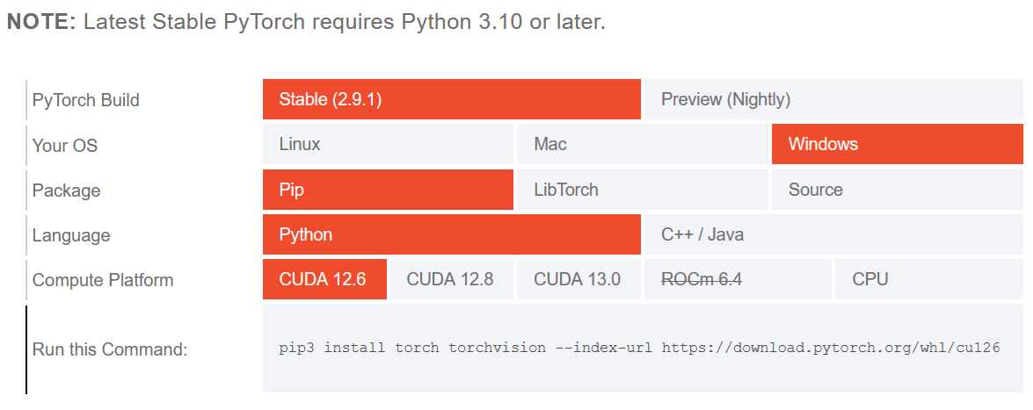
Installing PyTorch & CUDA:
https://pytorch.org/get-started/locally/

Slide 5
Conda install
Prefer using ‘conda install’ over ’pip install’, like:
  conda install pytorch torchvision torchaudio cudatoolkit=10.2 -c
  conda install -c conda-forge tensorboard
    *tensorboard was made for tensorflow BUT can be used w/PyTorch
  pip install torchviz
    *sometimes conda install option not available.
    *Torchviz requires GraphViz to be installed first.
Often need to create environment (like PyTorchStepByStep):
  conda env create -f environment.yaml

Slide 6
Computer PyTorch installs
main Win10 Ryzen5 7600X3D 4100Mhz 64gb RTX3060 12gb:
  Has Python 3.9 PyTorch that works in Visual Studio
Ubuntu Ryzen 5 5500 2400Mhz 32gb RTX4060Ti 16gb:
  Visual Studio Code will run the conda environments including:
    ldm
    pytorchbook
  *But how to debug on Linux?!?
  The pytorch jupyter notebooks seem to work well with it.
  Probably better to ‘conda pytorchnotebook’ and then ‘code’ to get into Visual Studio Code
Laptop Win11 i5-134020H 2100Mhz 16gb RTX4050 6gb:
  Has Python 3.9 PyTorch that works in Visual Studio
Gaming Win11 Ryzen9 7900X(12c) 32gb RTX5070 12gb
Mac Mini 16GB: PyTorch is possible but slow

Slide 7
Books and what they cover
Deep Learning with PyTorch step-by-step :
  Daniel Voigt Godoy, 2024 v1.2, PyTorch
  Have paperback & Kindle version. There is Volume II and III, though, I don’t have.
  \git\PyTorchStepByStep
Deep Learning with PyTorch:
  Stevens / Antiga / Viehmann, 2020, PyTorch
  \git\dlwpt-code
  Have paperback.
Deep Learning for Dummies 2019:
  Tensorflow & Keras
  \git\dl4dummies
Deep Learning with Python 2018:
  Tensorflow & Keras
  \git\deep-learning-with-python-notebooks

Slide 8
Dynamic Computation Graph
DAG (Directed Acyclic Graph) of operations
  Allows models to optimized at run-time:
    Can change shape/size and operations after each iteration if needed

Slide 9
Inherit from nn.Module to create Neural Net
class MyNet(nn.Module):
  def __init__(self):
    # Init the neural network
    super.__init__()
    # Flatten data, such as 28x28 image to linear array/tensor.
    self.flatten = nn.Flatten()
    # Add layers as needed:
    self.linear_relu_stack = nn.Sequential(
      nn.Linear(28*28, 512),
      nn.ReLU(), # Linear activation function outputs node or zero if not important.
      nn.Linear(512,512),
      nn.Linear(512,10)) # Output the 10 labels the model is trying to predict.

Slide 10
TorchVision
Transforms / datasets / models for computer vision
Models such as:
  resnet18: convolutional NN that is 18 layers deep
  resnet50, resnet101, etc.
  EfficientNet?
  Swin Transformers?
transform = transforms.Compose([
transforms.Resize((img_size, img_size)),
transforms.ToTensor(),
transforms.Normalize(mean=[0.485, 0.456, 0.406],
std=[0.229, 0.224, 0.225]),
])

Slide 11
TorchAudio
Speech Recognition
Wave data-to-vector transforms

Slide 12
CNN = Convolutional Neural Net
Convolution combines two math functions to produce a third
  Conv2D is used for 2D-image convolution
In image recognition, images are filtered for various features
  Kernels = learnable filters that are adjusted during training
  Detect on the filtered image (ReLU)
The filters/kernels are slid over the input image to create a product at each position, followed by summation to produce an output feature map
bias = offsets or shift adjustment
CNN usually uses multiple filters simultaneously
  Many features in each layer
  Many layers allow complex heirarchical combos of features

Slide 13
ReLU function
Rectified Linear Unit
Introduces non-linear element to learn complex non-linear relationships
Simple function: ReLU(x) = max(0, x)
ReLU variants:
  Leaky ReLU() = max(alpha*x, x). Small slope for negative part.
  Parametric ReLU - has slope that is learned during training
  Exponential Linear ELU - for very small inputs

Slide 14
Fully connected layers at end
for classification or regression tasks
Can be multiple fully connected layers
Combines the previous convolutional layers to bring everything together to give final classification

Slide 15
Object Detection models
recognize multiple objects in same image
YOLO - You Only Look Once - single stage/pass
  Darknet latest version is v4 but is continually being improved
    https://www.ccoderun.ca/programming/yolo_faq/
    https://github.com/hank-ai/darknet
  Non-Darknet versions are v5+
    *Note that Ultralytics does not own Yolo! You can make these models on your own, but they do provide pre-trained weights and super-easy python library (pay if commercial).
    v5: https://github.com/ultralytics/yolov5
    v11: https://github.com/ultralytics/ultralytics
Faster R-CNN - multiple stage
    RPN (Region Proposal Network) first, then classifies from there.
    Slower but more accurate especially for complex scenes & small overlapping
DETR - Detection Transformer
    Requires a lot of training data

Slide 16
Image Recognition Models that only
recognize the entire image at once
ResNet
MobileNet - Made for Mobile devices
EfficientNet v2 - has variants for different needs
Slower but could be optimized:
  Swin Transformer
  ConvNeXt - modern CNN better than transformers
  CoCa / PaLI / CoAtNet - state-of-the-art / best accuracy

Slide 17
Object Recognition Models Output
Yolo v4 output:
  Class ID zero-based
  Floating point confidence score
  Bounding box: x, y, width, height
    x,y might be relative to cell?

Slide 18
Object Detection on Edge devices
Raspberry Pi AI Hat (26 Tops)
  What models are available on this??
    Can the output be parsed to identify where the object is??
Nvidia Jetson Orin Nano (40 Tops)
  What models are available on this??
  Have 2 of these: 8GB and 4GB versions
    Take NVME hard drives
  New versions:
    Super version w/67 Tops $250
    AGX Orin 275 Tops $999
    Thor 2070 Tops $2799

